Slide 1
Relationship between winning and multiple opportunities among Game participants
By: Godfred Sakyi-Badu
Saturday, 25 June 2022

Slide 2
Introduction
Sports Stats data set from 1896 to 2016 was used for this project
Participants had an entry for each event he/she participated in
Participants details included
Demographics
Game
Team of affiliation
Event participated in
Whether or not a medal was won in the particular event

Slide 3
Hypothesis
Participating in one game multiple times in different games is likely to increase your chance of winning a medal.
Countries with a high number of participants in these games have a much higher number of medals won.
Participants with higher number of events participation has multiple medals won
United States has the highest number of medals won in these Games

Slide 4
Data cleaning and organization
Data was joined to a regions data to determine the region each participant originated from
Data was organized into multiple tables with relations among individual tables for analysis
Data cleaning
Age changes over time were computed
Age at first event and age at the last event
Height and Weight remained constant
One team was chosen for participants who had a switch of teams
Some ids were missing from the data base
NA were eliminated from the data when computing for descriptive statistics

Slide 5
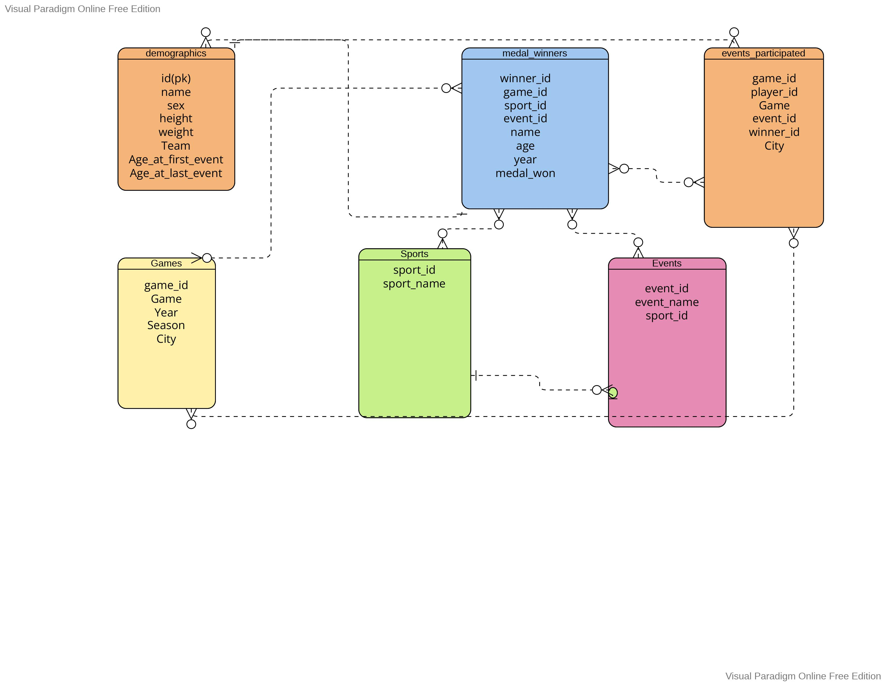
Organization of data in Tables
ER diagram showing the organization of the tables for analysis and their relationships with each other

Slide 6
Descriptive Statistics by region

Slide 7
Results
Player ID | Number of Events Participated | Award Winner
77710 | 58 | 1
106296 | 39 | 1
115354 | 38 | 0
119591 | 36 | 1
129196 | 32 | 1
119590 | 32 | 1
89187 | 32 | 1
53240 | 32 | 1
44875 | 32 | 1
106156 | 31 | 0
83312 | 31 | 0
76437 | 31 | 0
55047 | 31 | 1
133279 | 30 | 1
120051 | 30 | 1
94406 | 30 | 1
89755 | 29 | 1
21462 | 29 | 1
74532 | 28 | 1
26196 | 27 | 1
1- Yes
0- No

Slide 8
Results

Slide 9
Results

Slide 10
Discussion
Out of the top 20 players with the most events participated, only 4 had not won a medal in any of the events they participated in
There is a strong positive correlation between Number of events a country has participated in the number of medals won all time(0.93).
However, only a weak positive correlation between the number of events a player has participated in and the number of medals won(0.19)
Linear regression model to estimate the number of medals won by a country is given as y= 0.21x – 119 where x is the number of events
R squared value of 0.86 showing the model is a great fit

Slide 11
DISCUSSION
The United States of America had the highest number of events participated in and also the number of medals won
However, Russia had the better winning percentage all time
33.04% for Russia compared to 29.87%
Robert Tait McKenzie had the highest number of events participated in all time
However, he only won one medal in all the events he participated in.
Out of the players who participated in more than 15 events in the games, Larysa Semenivna Latynina had the highest number of medals won
Winning a medal in 18 of the 19 events she participated in

Slide 12
Conclusion
Although participation in multiple events increases the chances of winning a medal
It does not necessarily correlate with winning a high number of medals for the players

Slide 13
Recommendations and actions
Further analysis into the type of medals won for the players and the events in which the medal was won
Determining to see if the player participated in the particular event multiple times before winning the medal in the event
Relationship between the different seasons for which the games were hosted and the number of medals won for the top winning countries

Slide 14
Thank you

